Slide 1

Valeo
Data Analyst Case Study
Hazem Zaki Abdel Hamid

Slide 2

Data cleaning and manipulation using Python
Hours Sheet
Engineering sheet
Remove unnecessary columns (containing same fixed value )
calendar
cost rate
Period from
Period to
Replacing them instead with 3 new Columns which gives the same meaning.
From my point of view, There were no Data cleaning needed in this sheet.
The only thing I did was creating a new column called (Date difference),to calculate the difference between the end date and the start date to figure out the number of days.

Slide 3
Identify trends and patterns.
Hours: With a Total of 626977 hours spent across all Departments,
Departments [Camera, Internal and Switches] had the Highest number of hours spent on open cases of 66 Hours, all departments spent a minimum of 1 hour on cases, except Wippers which spent 8.
Forecasted hours: With a Total of 638283 hours spent across all Departments,
Maximum of 40 hours were spent by All Departments except for Wippers which was 13 hours.
Minimum of 1 hour were spent by All Departments except for [ Thermal and Wippers] which was (2, 6) hours consecutively.
Budget Hours: With a Total of 637638 hours spent across all Departments,
Maximum of 40 hours were spent by All Departments except for Wippers which was 23 hours.
Minimum of 1 hour were spent by All Departments except for Wippers which was 5 hours
HOURS sheet: I filtered open cases only, then I took the sum of (hours, Forecasted hours and Budget hours) columns and Calculated the Max, Min and Average hours of each Department and plotted [Table 1]
 | Hours (626977) |  |  | Forecasted hours (638283) |  |  | Budget Hours (637638)
Department | Max | Min | Avg | Max | Min | Avg | Max | Min | Avg
Camera | 66 | 1 | 22 | 40 | 1 | 20 | 40 | 1 | 20
Innovation | 65 | 1 | 21 | 40 | 1 | 20 | 40 | 1 | 21
Internal | 66 | 1 | 19 | 40 | 1 | 20 | 40 | 1 | 20
Power Strain | 40 | 1 | 18 | 40 | 1 | 20 | 40 | 1 | 21
Services | 40 | 1 | 17 | 40 | 1 | 20 | 40 | 1 | 20
Switches | 66 | 1 | 21 | 40 | 1 | 21 | 40 | 1 | 20
Thermal | 48 | 1 | 19 | 40 | 2 | 19 | 40 | 1 | 21
Tooling | 52 | 1 | 18 | 40 | 1 | 21 | 40 | 1 | 20
Visibility | 51 | 1 | 20 | 40 | 1 | 20 | 40 | 1 | 21
Wippers | 24 | 8 | 16 | 13 | 6 | 10 | 23 | 5 | 14
Table 1

Slide 4
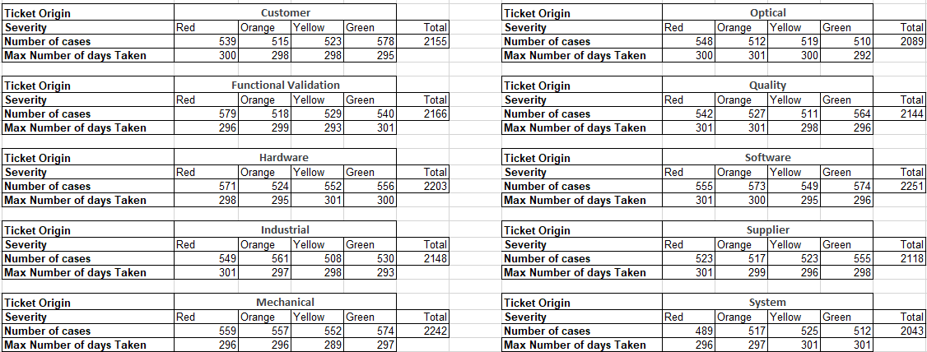
ENGINEERING Sheet:
Linked status column from Hours Sheet to stage Column in Engineering Sheet using VLOOKUP
filtered status column (open cases) & stage Column (closed)
[Table 2] is regarding each Ticket origin uniquely, describing in each severity the number of cases and the Maximum number of days it took to close the case (date Difference).
Table 2
A Total of 21559 cases were opened, with an Average of 2156 cases per Ticket origin, with Software making the Highest number of cases (2251) and System making the lowest (2043).
From The 21559 cases, the ranking of each severity is shown in [table 4] , with green a total of 5493 being the highest , and Yellow with a Total of 5291 being the lowest .
Ticket Origin | Total
Customer | 2155
Functional Validation | 2166
Hardware | 2203
Industrial | 2148
Mechanical | 2242
Optical | 2089
Quality | 2144
Software | 2251
Supplier | 2118
System | 2043
Severity | Total cases
Green | 5493
Red | 5454
Orange | 5321
Yellow | 5291
Table 3
Table 4

Slide 5
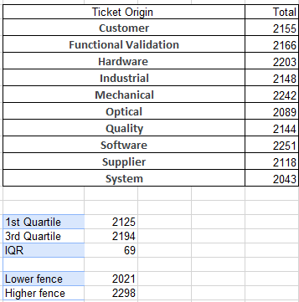
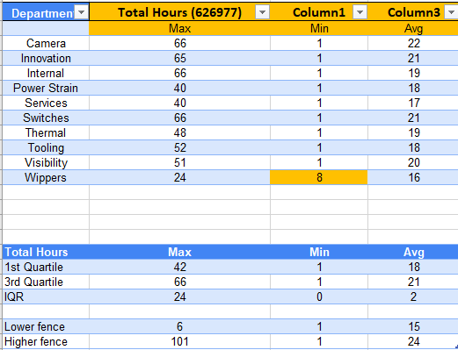
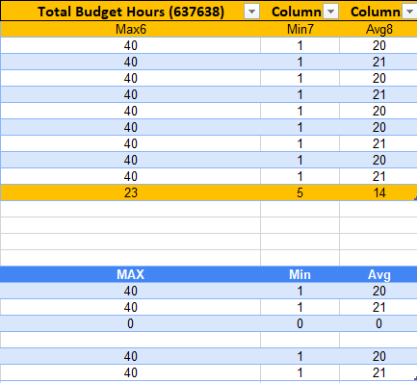
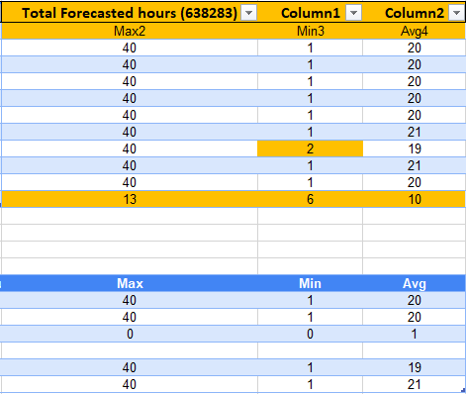
Identify outliers and explain data treatment steps Calculate the IQR to know for sure the outliers: [table 1]
1st Quartile =QUARTILE.INC (Table2[Total Hours (626977)],1)
3rd Quartile =QUARTILE.INC (Table2[Total Hours (626977)],3)
IQR = 3rd Quartile- 1st Quartile
Lower fence = 1st Quartile – (IQR * 1.5)
Upper fence = 3rd Quartile + (IQR*1.5)
Then using conditional formatting I marked the values that doesn’t fall between the Lower and Upper fence
OUTLIERS, Hours: WIPPERS /Forecasted hours: Wippers & Thermal /Budget Hours: Wippers
I did the same on [table 3], which didn’t mark any Outliers because all values lie within the given range.
Table 6
Table 5

Slide 6
Identify reasonable SLA for tickets
Based on the severity of the ticket, the date difference (days worked on case) shouldn’t exceed a specific number of days.
For example, Calculating the average and maximum days taken to solve cases that were opened with severity RED and GREEN.
We notice that: Average days of both Severities are almost the same, and the Maximum days of both severities are exactly the same.
So, a reasonable SLA for tickets would be to prioritize Cases with RED severity by minimizing the Average Days and Maximum days say by 30% and also adjusting the SLA for Green, yellow and orange.
Because it’s not rational that the Most severe cases and the Least severe case should take the same number of days to be closed
KPI’s for representing data :
Departments
Hours / forecasted / budget
Ticket origin
Cases Severity
Date difference
**Please note that I created 2 dashboards using Power BI that I have attached with the power point**
Severity | Average Days | Maximum Days | Total Cases
Red | 150 | 301 | 5454
Green | 153 | 301 | 5493

Slide 7


